Slide 1
Lab 4 Clustering
Dr. Liang
Notes:
Welcome to us!

Slide 2
Outline
Introduction
Lab4 description
Result analysis
Task description
Submission requirement
Notes:
Who am I? Who are you? ☺

Slide 3
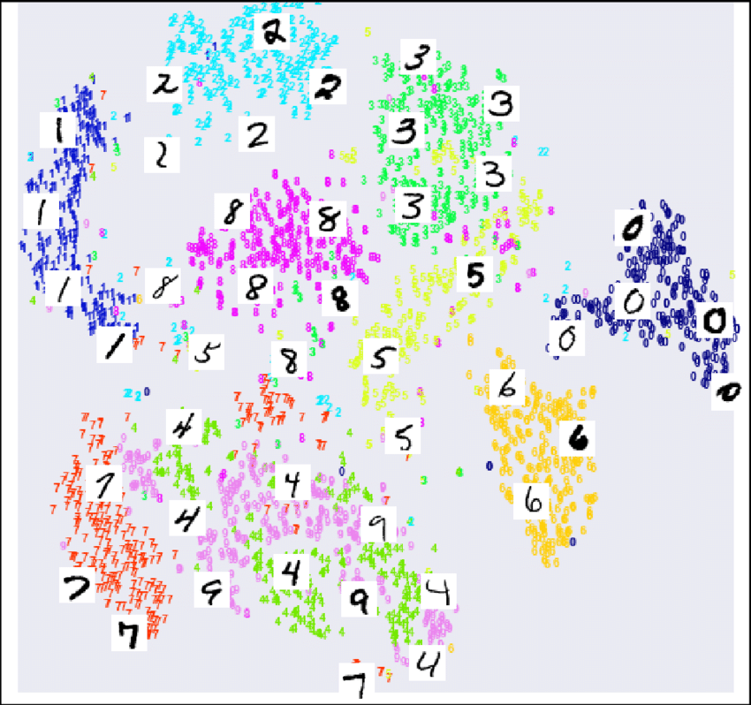
Introduction---Clustering
Clustering: clustering is the task of grouping a set of objects in such a way that objects in the same group (called a cluster) are more to each other than to those in other groups.
In my words, grouping similar things together makes classification easier. For example, in Lab 1, handwritten samples that are closer in appearance are easier to classify
Notes:
Who am I? Who are you? ☺

Slide 4
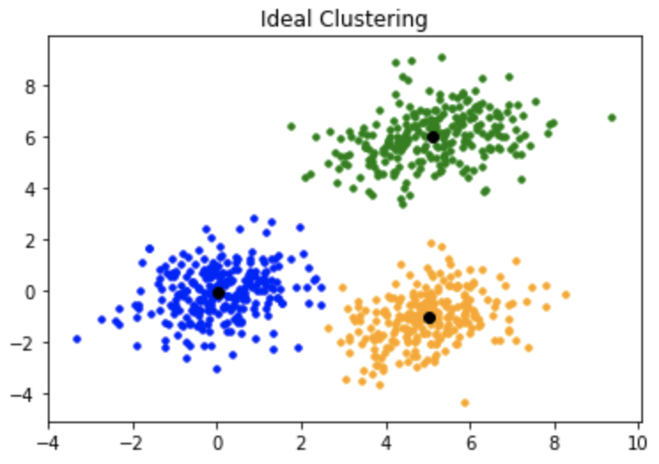
Introduction---Clustering
K-means: find the best centers of the clustering points
K-means is very similar with KNN, but it belongs to unsupervised learning --- we do not have the label in the dataset.
Notes:
Who am I? Who are you? ☺

Slide 5
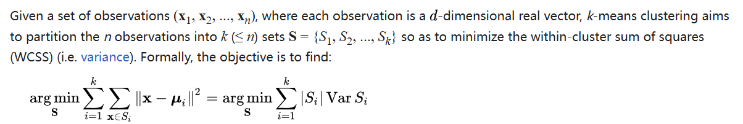
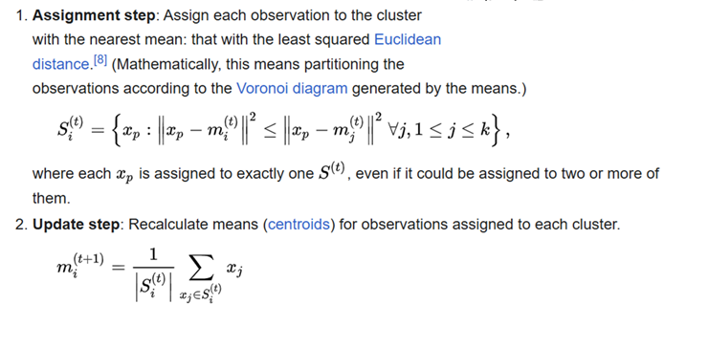
Introduction--Kmeans
K-means: find the best centers of the clustering points
https://en.wikipedia.org/wiki/K-means_clustering
Notes:
Who am I? Who are you? ☺

Slide 6

Introduction---Metrics
Question: which is the best hyper parameter K?
Metrics to evaluate the K
1 Sum of Squared Errors (SSE):
Only consider their own class
C1
D2
C2
D4
D1
D3
SSE = D1+D2+D3+D4
The smaller, the better!
Notes:
Who am I? Who are you? ☺

Slide 7
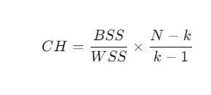
Introduction---Metrics
Question: which is the best hyper parameter K?
Metrics to evaluate the K
2 Calinski-Harabasz (CH):
Consider both their own class and different class
C1
D2
C2
D4
DD1
D1
D3
WSS = D1+D2+D3+D4 BSS=DD1
The larger, the better!
Notes:
Who am I? Who are you? ☺

Slide 8


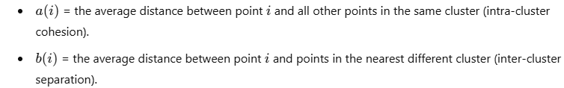
Introduction---Metrics
Question: which is the best hyper parameter K?
Metrics to evaluate the K
3 Silhouette Score(SS)
Consider both their own class and different class
i
C1
D2
D1
a(i)=(D1+D2)/2
b(i)=D2
The smaller, the better!
Notes:
Who am I? Who are you? ☺

Slide 9
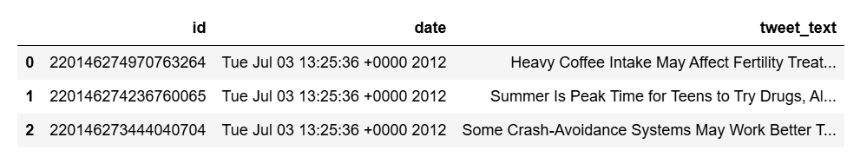
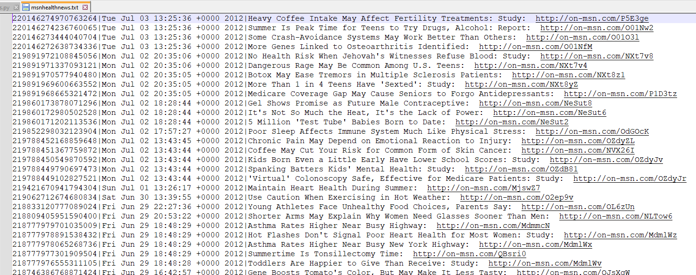

Lab4 description
Dataset: MSN from different health care company
Notes:
Who am I? Who are you? ☺

Slide 10
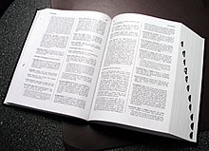
Lab4 description
Task: Find the possible health trends from the document
How to change words into number? Otherwise computer could not deal with words.
Use the dictionary. For example:
4147 pages, one word one page
I love Machine Learning!
Page 34, 56, 4000, 739
Use a vector to represent it as [34, 56, 4000, 739]
Notes:
Who am I? Who are you? ☺

Slide 11
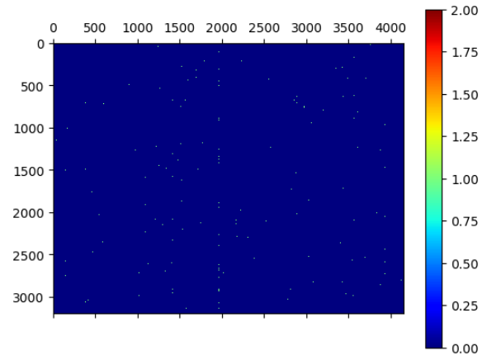
Lab4 description
Go back to the txt
total 4147 words as dictionary
total 3199 sentences vector
Notes:
Who am I? Who are you? ☺

Slide 12

Lab4 description
Each sentence is a vector, how to measure the distance of two sentences
I love Machine Learning!
Page 34, 56, 4000, 739
Use a vector to represent it as [34, 56, 4000, 739]
I love Artificial Intelligence!
Page 34, 56, 4001, 740
Use a vector to represent it as [34, 56, 4001, 740]
I love Halmstad University!
Page 34, 56, 200, 40
Use a vector to represent it as [34, 56, 200, 40]
Euclidean distance:
Sqr (34-34)²+(56-56) ²+(4000-4001) ²+(739-740) ²
=
Euclidean distance:
Sqr (34-34)²+(56-56) ²+(4000-200) ²+(739-40) ²
≈ 67
Notes:
Who am I? Who are you? ☺

Slide 13
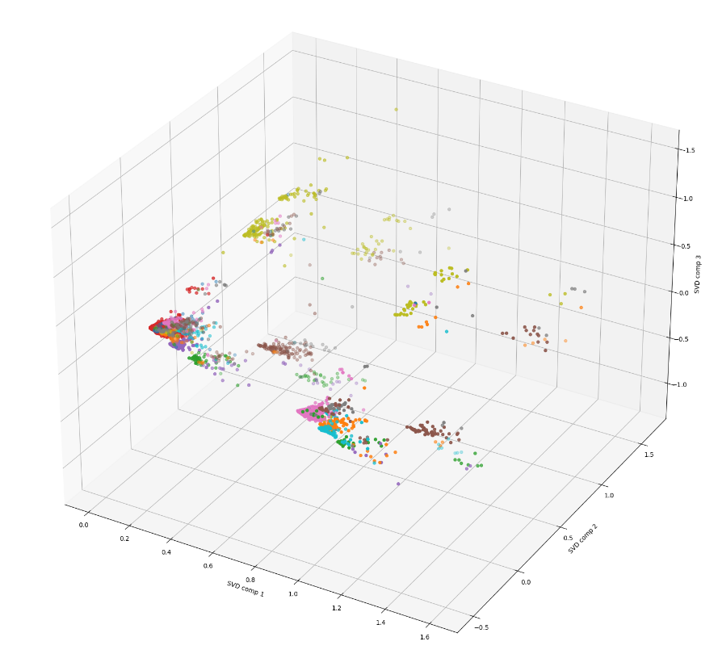
Result analysis
Now we could calculate 3199 sentences (point) distances
Notes:
Who am I? Who are you? ☺

Slide 14
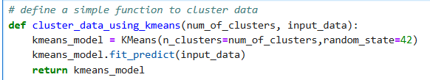
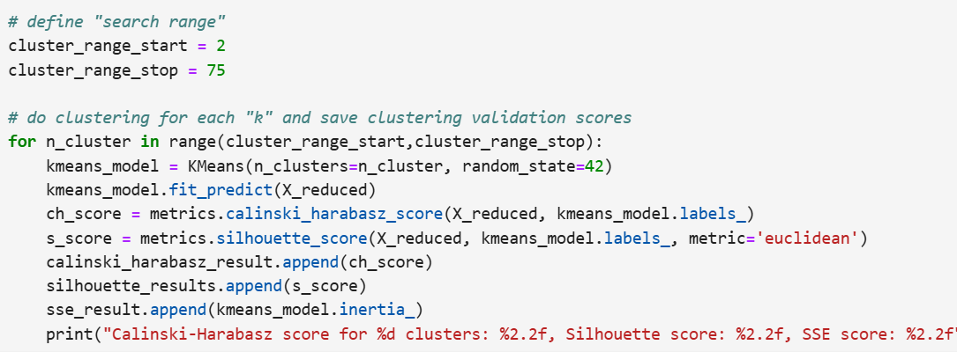
Result analysis
How to use Kmeans
But How to choose the suitable K value? Think about the slide window in lab 3
Grid search, input K from 2 to 75 and find the best metrics.
Notes:
Who am I? Who are you? ☺

Slide 15
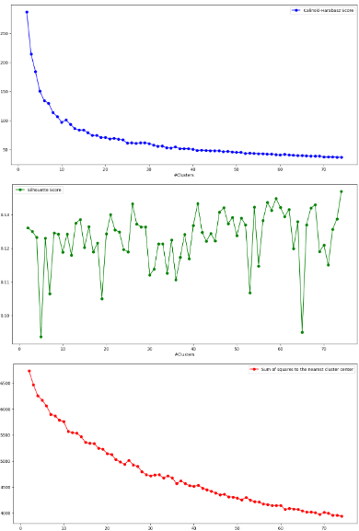
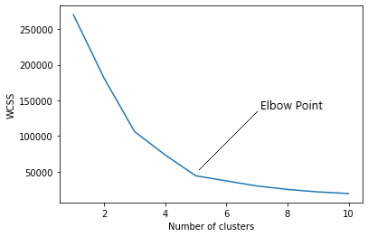
Result analysis
Question：
Which is the best K?
Notes:
Who am I? Who are you? ☺

Slide 16
Result analysis
-----------CLUSTER 0-----------
could psoriasis increase odds for type 2 diabetes?: diabetes may hasten mental decline: more progress made on artificial pancreas for diabetes patients: many people with type 1 diabetes missing treatment goals: study: obesity, diabetes may raise complications after joint replacement: bigger waist tied to increased risk of diabetes: diabetes can take a toll on your emotions: oxygen therapy slows type 1 diabetes in mice, study says: could eating fast increase diabetes risk?: two-drug therapy helped kids with type 2 diabetes: value of metformin, insulin combo for type 2 diabetes questioned: diabetes groups issue new guidelines on blood sugar: common plastics chemical might boost diabetes risk: mouse study hints at new path for diabetes treatment: new type 2 diabetes drug helps lower blood sugar: study: as white rice intake rises, so may your risk for diabetes: type of bacteria may be linked to diabetes: stroke risk rises with duration of type 2 diabetes: study: type 1 diabetes may develop more slowly than thought: when mom has pregnancy diabetes, breast-feeding curbs child obesity:
-----------CLUSTER 1-----------
heavy coffee intake may affect fertility treatments: study: more than 1 in 4 teens have 'sexted': study: kids born even a little early have lower school scores: study: toddlers are happier to give than receive: study: study of retired nfl players finds evidence of brain damage: gay or straight, parents too tired for sex, study suggests: residents as good as fully trained docs if properly supervised: study: eating vegetables may protect pancreas, study suggests: under right conditions, fertility treatment can equal natural conception rates: study: exercise won't affect breast milk, baby's growth: study: active, outdoor teens are happier teens: study: more than half of resident docs have worked while sick: study: dramatic rise in kids hospitalized with high blood pressure: study: infant vaccination 'delays' triple in oregon: study: american kids getting fewer prescription drugs: study: more people stay 'connected' on vacation via web: study: fathers can teach their children persistence: study: state laws cut teen drinking and driving, large study shows: graphic cig pack labels make smokers think, study finds: unsafe sex common when partner cheats: study:
-----------CLUSTER 2-----------
botox may ease tremors in multiple sclerosis patients: 'virtual' colonoscopy safe, effective for medicare patients: study: 1 in 10 fibromyalgia patients uses marijuana to ease pain: limited use of antibiotics ok for dental patients: study: fatigue in copd patients often precedes hospitalization: study: statins may leave patients with less energy: study: fewer medicare patients being 'admitted' to hospitals: study: patients may receive too much acetaminophen in hospital: patients prefer more invasive form of colon scan: study: plavix's new generic status could be boon for patients: for dementia patients, feeding tubes may increase bed sores: using earplugs eases icu patients' confusion: study: psychiatric patients often wait nearly 12 hours in er: in some brain bleeds, patients do better at high-volume hospitals: testosterone supplements might help patients with heart failure: newer antidepressants may be safe for parkinson's patients: many patients skip recommended colonoscopy: study: gastro woes often strike rheumatoid arthritis patients: thyroid surgery riskier for older patients: study: 'superinfected' patients give clues to fighting hiv:
Notes:
Who am I? Who are you? ☺

Slide 17
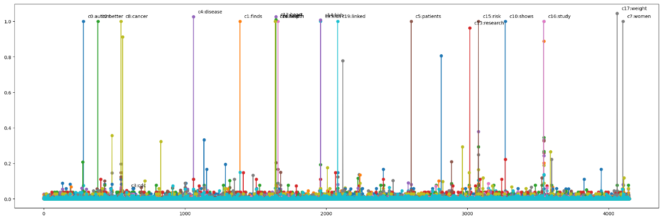
Result analysis
The most frequent words in each cluster
Assumption: more repeat in different sources, more important content
Notes:
Who am I? Who are you? ☺

Slide 18
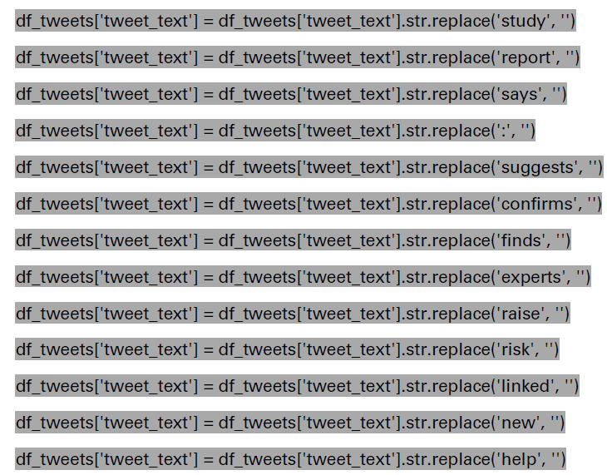
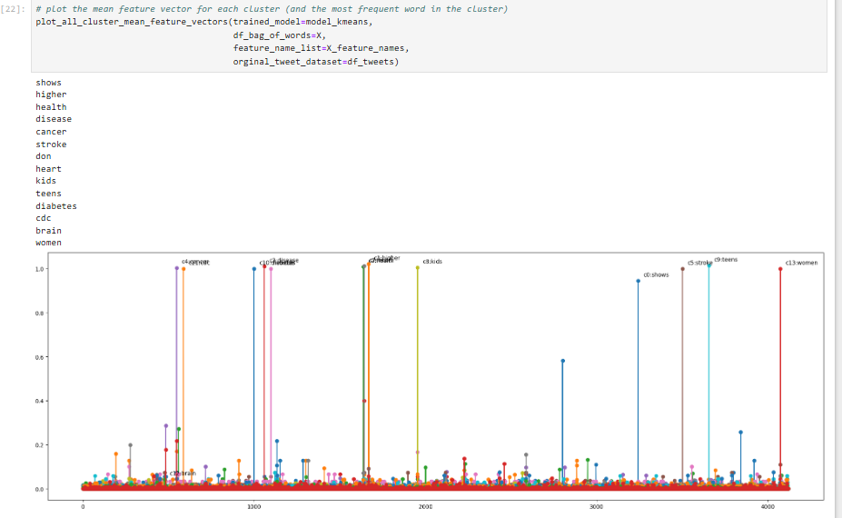
Task description
Task 1 Run the example code
Task 2 Answer: k=2 make sense?
Task 3 Set k=8, see the result resonable?
Task 4 remove useless information and run the code again to see what happen
Task 5 choose a better suited k by 3 metrics to see which k is better?
Task 6 based on task 5 print the cluster content and express the health care topic trend.
Notes:
Who am I? Who are you? ☺

Slide 19
Submission requirement
Submission including the code from this lab
Outline:
1 Introduction & Motivation;
2 Methods & Solutions;
3 Results;
4 Conclusions & Discussion;
5 Appendix (Option).
≤ 5pages
Use your own words
Deadline: 1 week latter (9 Mar including the weekend)
Submit in group (each group only need to submit one report)
Notes:
Who am I? Who are you? ☺

Slide 20
Thank you!
Notes:
If any questions – Helpdesk HR helpdesk.hr@hh.se

